Slide 1
Group- 255
The Blue Badge:
An innovation for visually impaired people

Slide 2

Group Members-
MVN Rajesh Reddy- 20BAI10249
Mohd Mohsin Khan - 20BAI10340
Shivansh Yadav- 20BCE10064
Saransh Yadav - 20BCE10150
Ayush Kumar- 20BCE1055
Abhisurendra Prajapati - 20BCE10338
Sourabh Sahu - 20MEI10033
Shalu Singh - 20MIM10122

Slide 3

Sourabh Sahu
Shivansh Yadav
Shalu Singh
Saransh Yadav
Team
Research
Mohd Mohsin Khan
Ayush Kumar
App Deployment
Coding and Implement-ation
MVN Rajesh Reddy
Abhisurendra Prajapati

Slide 4
Table of Contents
01.
Introduction
Overall System Architecture Diagram
06.
02.
Literature Review
07.
Module Description
03.
Existing work & Limitation
Implementation of Code
08.
04.
Proposed work & Methodology
Input / Output of Code
09.
Novelty & Requirements
05.
10.
Future Work

Slide 5
INTRODUCTION
Globally, there are at least 2.2 billion people with near or distant vision impairment.
In India, there are 9.3 million visually impaired people, including 2,70,000 blind children.
Devices used by the blind to navigate are not sufficiently accessible since they primarily rely on infrastructural needs.
Blind people face challenges in finding their way through rooms or along varied travel routes.
People who are blind or partially sighted deal with numerous issues every day and are constrained in practically every area of their existence, including movement and judgment.
They must deal with challenges when trying to communicate information and access it.
Their social, professional, and personal lives are impacted as a result.
In order to tackle these challenges we came up with an idea of creating an app to help blind individuals navigate, provide visual support we can empower and support this community in their daily lives, helping them feel more confident and independent.
This project can make a meaningful and positive impact on the lives of blind individuals, and we should be motivated to undertake it to give back and make a difference.

Slide 6

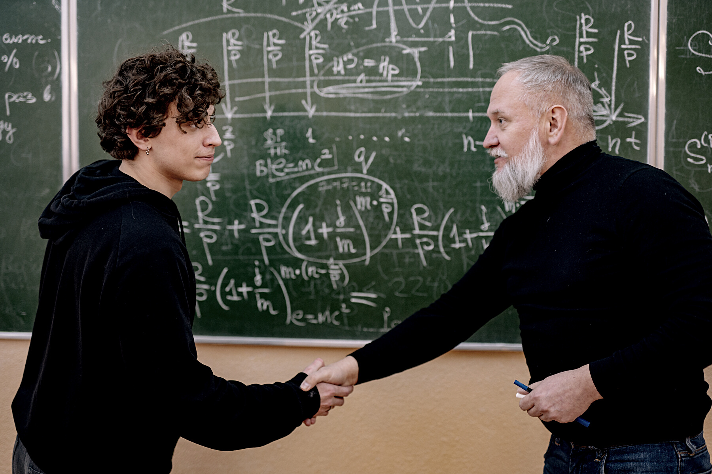
02. Literature Review
OBJECT DETECTION
DISTANCE DETECTION
TEXT-TO-SPEECH CONVERSION

Slide 7
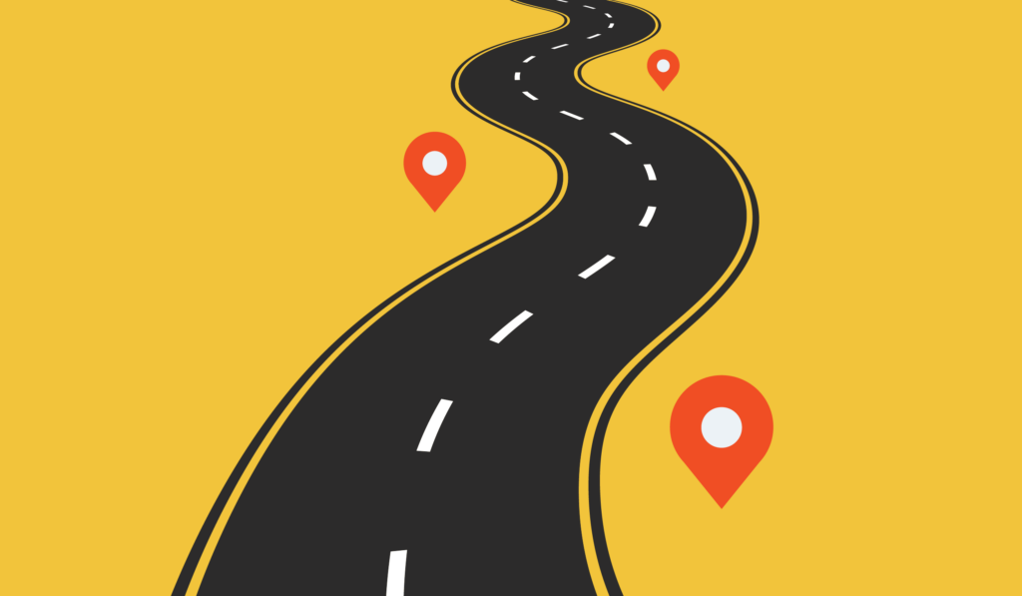

03. Existing Work and Limitations

Slide 8
Existing Work
Object Detection
YOLO algorithm works using the following three techniques:
• Residual blocks
• Bounding box regression
• Intersection Over Union (IOU)

Slide 9
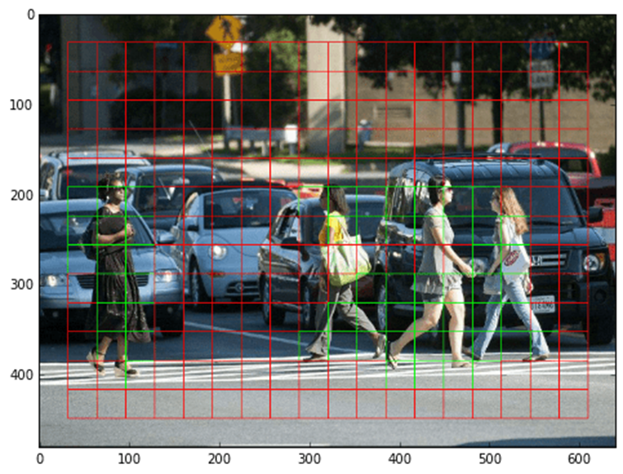
Residual blocks
First, the image is divided into various grids. Each grid has a dimension of S x S. The following image shows how an input image is divided into grids.

Slide 10
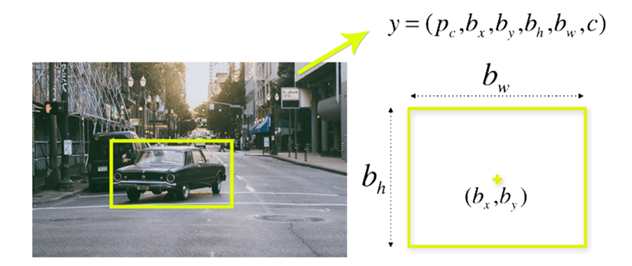
Bounding box regression
A bounding box is an outline that highlights an object in an image.
Every bounding box in the image consists of the following attributes:
o Width (bw)
o Height (bh)
o Class (for example, person, car, traffic light, etc.)- This is represented by the letter c.
o Bounding box center (bx,by)

Slide 11
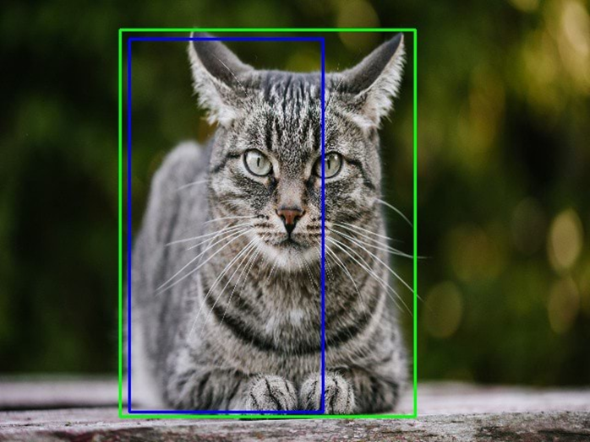
Intersection Over Union (IOU)
Intersection over union (IOU) is a phenomenon in object detection that describes how boxes overlap. YOLO uses IOU to provide an output box that surrounds the objects perfectly.
Each grid cell is responsible for predicting the bounding boxes and their confidence scores.

Slide 12
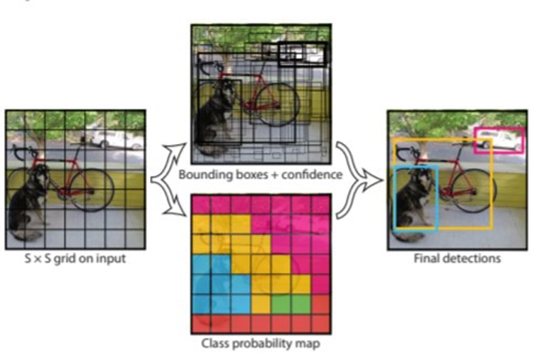
Combination of the three techniques
The following image shows how the three techniques are applied to produce the final detection results.

Slide 13
Existing Work
2. Distance detect
By default, it cannot estimate the distance of the object. Our goal is to add this ability to YOLO to create Dist-YOLO, while preserving the original properties. To achieve this capability, three basic steps must be followed:
Enrich the labels in the training dataset with information about distances.
Extend the prediction in each cell to produce the distance of an object.
Update the YOLOv3 loss function used for training to take into account the distance of an object.

Slide 14
A prediction vector p of cell and anchor at a certain scale is given as p=(b,c,o) where b=(x,y,w,h) are coordinates produced by a bounding box regressor, c=(c1, c2, c3,….,cn) that addresses the confidence of being a certain class up to n classes, and o expresses objectness.
Each prediction vector consists of 5+n values, and we have 3×3×r prediction vectors, where r is the number of all cells in the three output layers. Typically, r = 14,157.
We extend the prediction vector into form p=(b,c,o,d)
Where we have two options of how to define d.
i. d=(d) if the distance is class-agnostic.
ii. d=(d1,d2,….,dn) if the distance is class-aware.

Slide 15
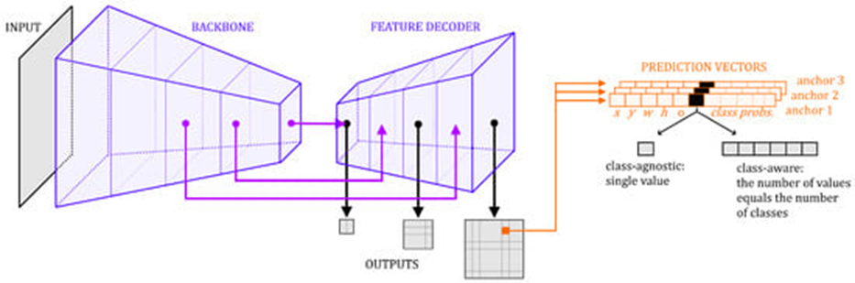
Prediction vector is produced by 1×1 convolutional filters.
When we add additional information (distance), it is necessary to increase the total number of these filters.
Each filter includes one trainable parameter

Slide 16
Existing Work
3. Text to voice
For text to voice we have use google text to speech.
It has a library and CLI tool in Python called gTTS to interface with the Google Translate text-to-speech API.
gTTS creates an mp3 file from spoken text via the Google Text-to-Speech API.
mpg321 to play these created mp3 files from the command-line.
gTTS supports quite a number of languages

Slide 17
Limitations
The user may confuse between how to react at the situation, as it may need training a bit.
The user may face that the voice is not that user friendly and sometimes hard to understand.
The phones that are used by visually impaired people work on vibrations so deploying an app for them will be one of the greatest challenges as we need to study the patterns for the same. (Research is going on)

Slide 18
04. Proposed Work
The Proposed work is that our project aims to develop a user-friendly and intuitive app that provides real-time audio instructions and information to assist blind individuals in navigating unfamiliar environments. The app will leverage advanced technologies such as location tracking, voice recognition, and artificial intelligence to provide accurate and reliable guidance to visually impaired users. The app will be designed to provide the following functionalities.
1. Real-Time Object detection and Recognition
2. Text-to-speech conversion
3. Image detection
4. Real-Time audio instruction
5. User Feedback

Slide 19

04. Methodology
The app is working method can be classified into three parts-
Image detection
The distance approximation
Text-to-speech conversion
So, basically we use yolov7 object detection model for, detection of object in image and along with of bounding box around the image. YOLO stands for You Only Look Once, and YOLO is a real-time object detection algorithm that uses a single convolutional network to predict bounding boxes and class probabilities directly from an image.
Digital Image Processing.
We use geometry to our advantage. Generally, when using one camera, distance to objects of know width can be estimated using the perceived focal length of the camera.
Where the Relation between width(w) and distance(d) in the physical space, Physical dimensions on the top, and dimensions in the pixel space on the bottom.
If we know the perceived focal length f in pixels of you camera we can use to approximate distances in the wild.
pyttsx3: pyttsx3 is a Python library that supports multiple text-to-speech engines. It provides a simple interface for converting text to speech and allows for customization of voice and speech parameters.
gTTS : (Google Text-to-Speech): gTTS is a Python library that uses the Google Text-to-Speech API to convert text to speech.

Slide 20
05.
Novelty of the Project

Slide 21
Novelty
Our app uses Python modules for object image detection to help blind and visually impaired people navigate their surroundings.
By leveraging cutting-edge image recognition technology, our app can identify objects in real-time, providing users with essential information about their environment.
The app uses a variety of computer vision techniques to detect and classify objects based on their visual features, including shape, size, and color.

Slide 22
Novelty
With our app, blind and visually impaired users can receive audio feedback about the location and distance of nearby objects, helping them navigate safely and independently.
Our innovative algorithm utilizes deep learning techniques to increase object detection accuracy and provide even more precise feedback.
Our goal is to help create a more inclusive and accessible world for all, by empowering those with visual impairments to navigate their surroundings with confidence and ease.

Slide 23
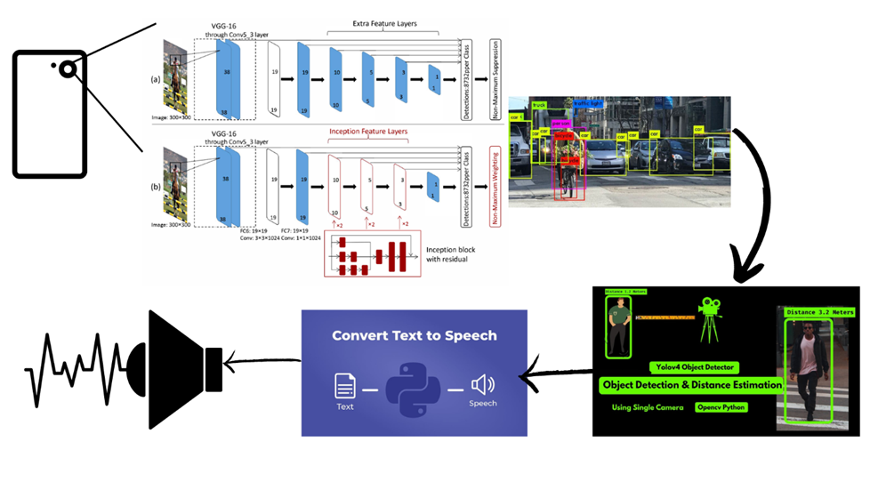
06. Overall System Architecture

Slide 24
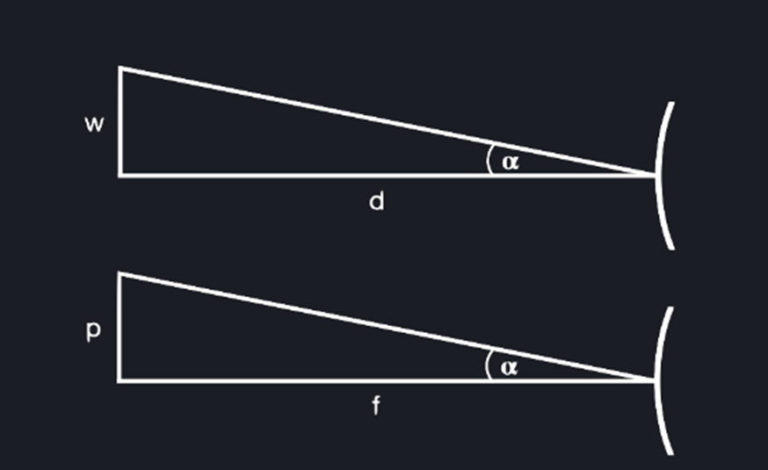
Working Principle
Part-1 Image Detection:-
Object Detection is a powerful technique which allows to detect objects in images.
Algorithm-Yolov7
Part -2 Distance Approximation Part:-
Fig: -1) Relation between width(w) and distance(d) in the physical space, Physical dimensions on the top, and dimensions in the pixel space on the bottom.

Slide 25
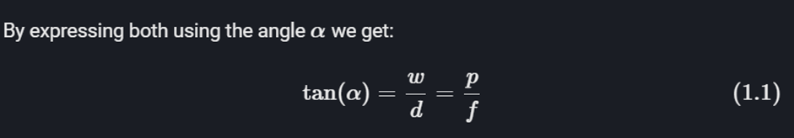
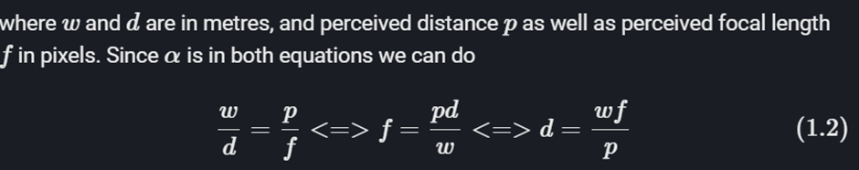
Working Principle
Example: - We assume the vehicles are 2m wide, which is the w. Then we use object detector to output a bounding box around it. This gives us the perceived width p in equation 1.2, with which we get the distance d.

Slide 26
Working Principle
Part -3) Converting the text output to speech:-
APIs in Python like ‘pyttsx 3’ package.
General idea is to convert known object and approximate distance from text to speech.

Slide 27
07.
Module Description

Slide 28

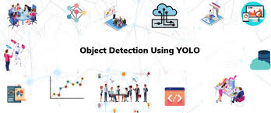
YOLO (You Only Look Once) is a method / way to do object detection. It is the algorithm /strategy behind how the code is going to detect objects in the image.

Slide 29
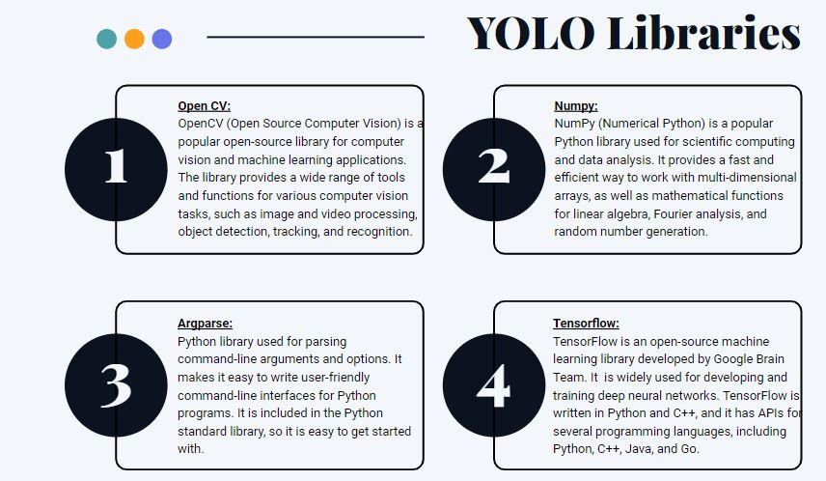
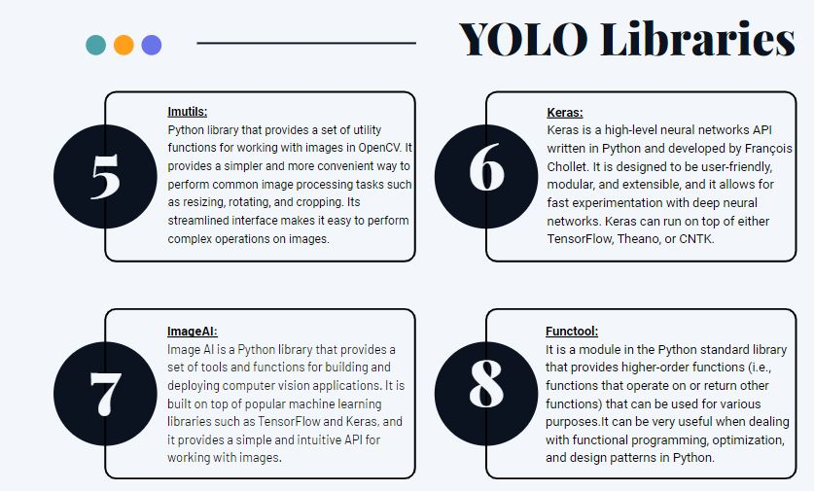

Slide 30
08.
Code Implementation:
Let’s go to VS Code for the step by step explanation

Slide 31
09.
Output

Slide 32
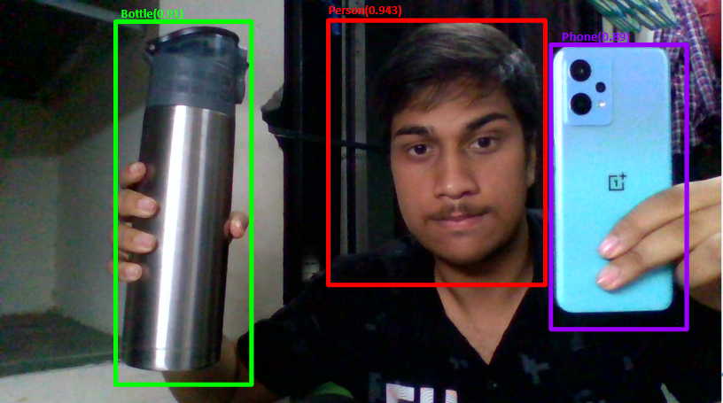

Slide 33
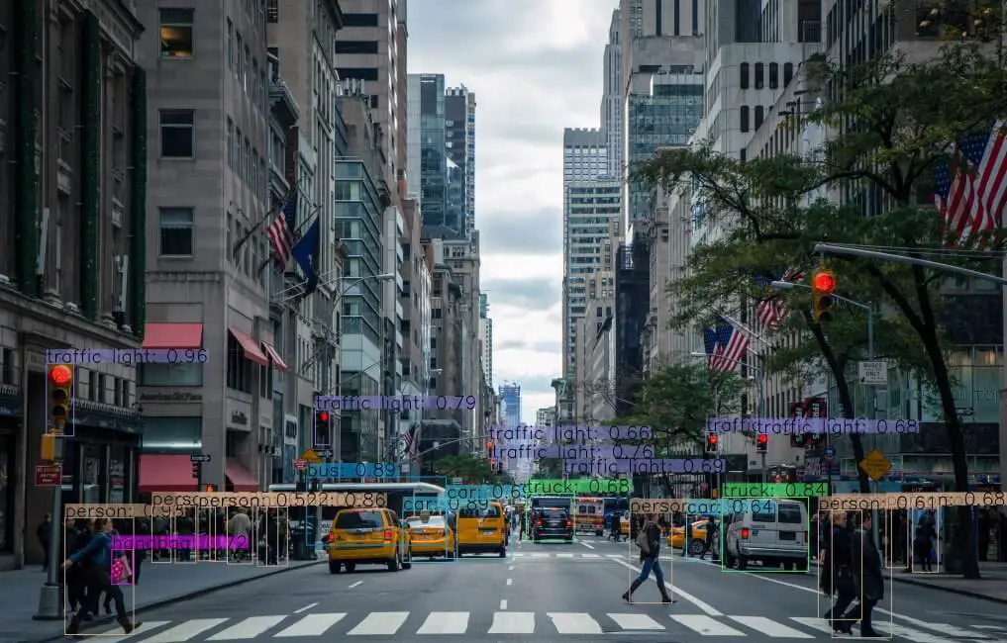

Slide 34
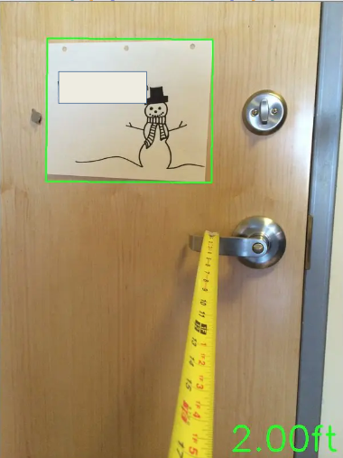

Slide 35
10. Future Work
Need to integrate all the three programs so that it give a fruitful result, rather than this we need something which gives the optimum distance to the user and they can understand clearly.
Need to build a App/ GUI so that a common visually impaired people can use.

Slide 36
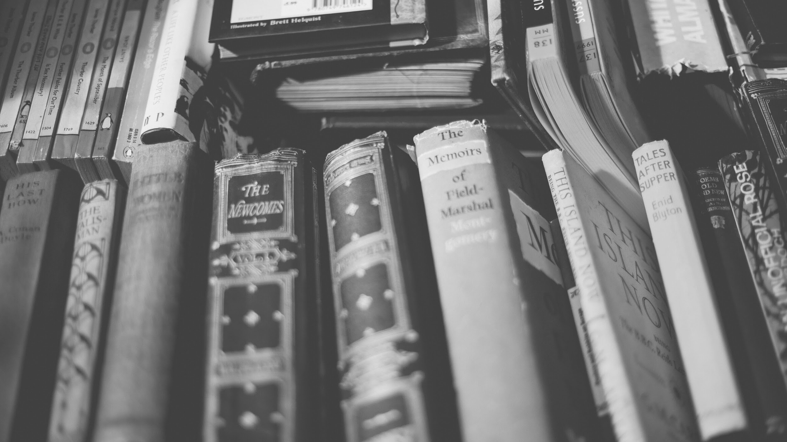
thank you!
That’s all from our side!!!

